Slide 1
The Bible in Art A series of courses run by Rev. John Dixon for the Central Lakes Mission Community
A selection of paintings that have been included in these courses

Slide 2
Conversion on the Way to Damascus (Caravaggio)

Slide 3
St Joseph and the Child Jesus (el Greco)

Slide 4
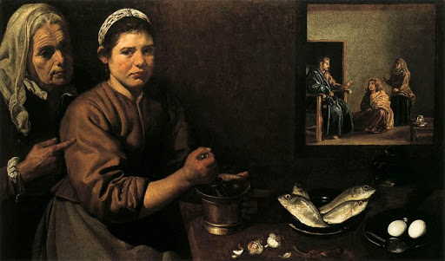
Christ in the House of Mary and Martha (Diego Velazquez)

Slide 5
The Baptism of Christ (Piero della Francesca)

Slide 6
Christ Driving the Money Changers from the Temple (El Greco)

Slide 7
The Annunciation (Fra Lippo Lippi)

Slide 8
The Supper at Emmaus (Caravaggio)

Slide 9
Agony in the Garden (Mantegna)

