Slide 1
This is the day that the Lord has made.
Let us rejoice and be glad in it.
Faithful one, whose word is life: come with saving power
to free our praise, inspire our prayer and shape our lives
for the kingdom of your Son, Jesus Christ our Lord.
Amen.

Slide 3
Invitation to confession
The Spirit of the Lord fills the world and knows our every word and deed.
Let us then open ourselves to the Lord and confess our sins in penitence and faith.

Slide 4
Confession
Jesus Christ, risen master and triumphant Lord, we come to you in sorrow for our sins, and confess to you our weakness and unbelief.
We have lived by our own strength, and not by the power of your resurrection.
In your mercy, forgive us.
Lord, hear us and help us.
We have lived by the light of our own eyes, as faithless and not believing.
In your mercy, forgive us.
Lord, hear us and help us.

Slide 5
We have lived for this world alone,
and doubted our home in heaven.
In your mercy, forgive us.
Lord, hear us and help us.
Absolution
May the God of love and power forgive us and free us from our sins, heal and strengthen us by his Spirit, and raise us to new life in Christ our Lord.
Amen.

Slide 6
Collect for the day:
O God, forasmuch as without you
we are not able to please you;
mercifully grant that your Holy Spirit
may in all things direct and rule our hearts;
through Jesus Christ your Son our Lord,
who is alive and reigns with you,
in the unity of the Holy Spirit,
one God, now and for ever.
Amen

Slide 7
Readings
1st reading: 1 Thessalonians 1:1-10 (Una Gordon)
Pause
2nd reading: Matthew 22: 15-22 (Sue Ion)

Slide 8
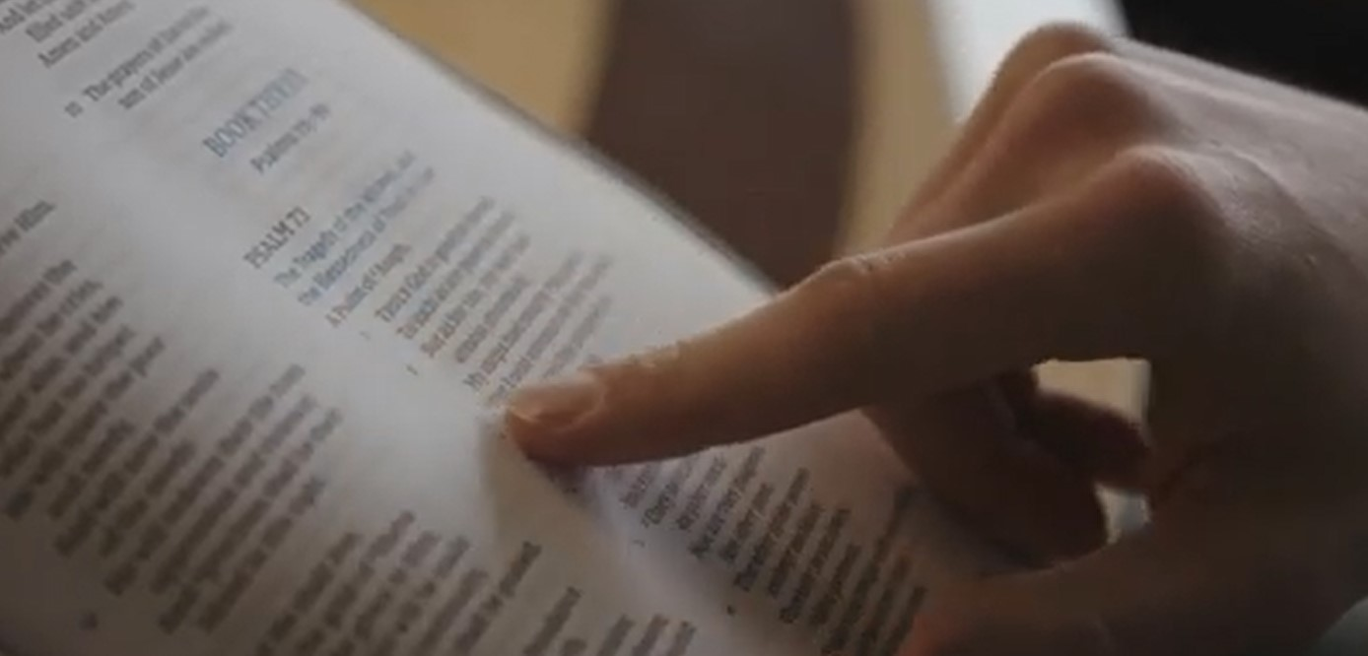
Reflection

Slide 10
Creed
Let us declare our faith in God.
All We believe in God the Father, from whom every family in heaven and on earth is named.
We believe in God the Son, who lives in our hearts through faith, and fills us with his love.
We believe in God the Holy Spirit, strengthens us with power from on high.
We believe in one God; Father, Son and Holy Spirit.
Amen

Slide 11
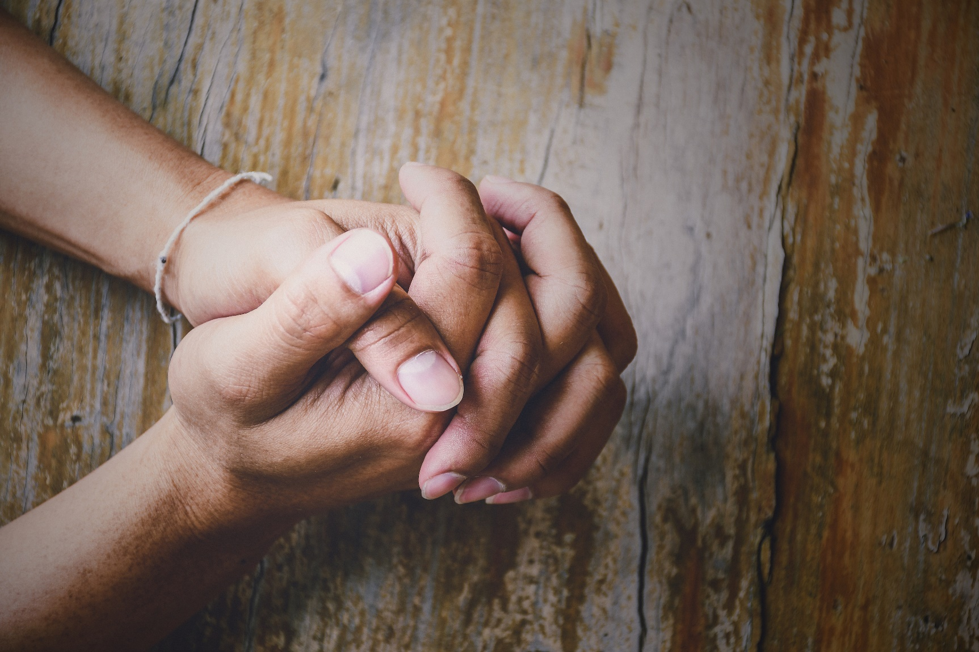
Intercessions:
The Lord’s Prayer

Slide 12
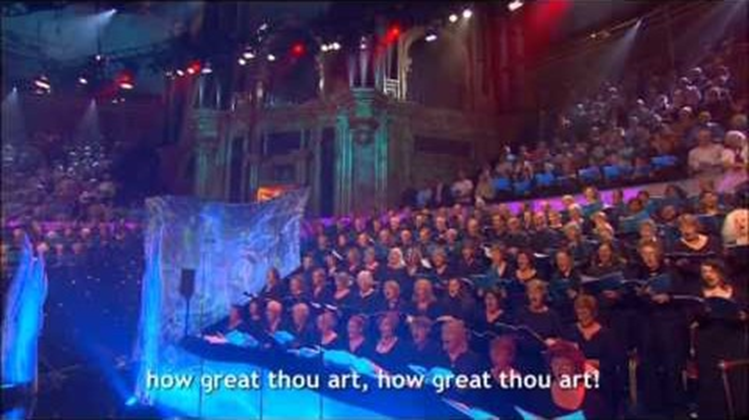

Slide 13
Conclusion:
O God our mystery, you bring us to life, call us to freedom, and move between us with love. May we so participate in your dance of trinity that our lives may resonate with you, now and for ever.
Amen
The grace

